Slide 1
Machine Learning & Public Policy Lecture 1: Prediction for Policy
Professor Edward McFowland III
Information Systems and Decision Sciences
Carlson School of Managment
University of Minnesota

Slide 2

What Is Machine Learning?

Slide 3
What Is Machine Learning?
Machine Learning (ML) is the study of systems that improve their performance at a task with experience (typically by learning from data)
Some related concepts include
Artificial Intelligence (AI) is the science of automating complex behaviors such as learning, problem solving, and decision making.
Data Mining (DM) is the process o f extracting useful information from massive quantities of complex data.
Statistics is a branch of mathematics dealing with the collection, analysis, interpretation, presentation, and organization of data.

Slide 4

What Is ML Good for?

Slide 5
What Is ML Good for?
Modeling Data and Learning Functions
Prediction/Classification
Grouping Data
Uncovering Correlations and Patterns

Slide 6

What Is Public policy?

Slide 7
What Is Public policy?
Public Policy (PP) is the means by which a government maintains order or addresses the needs of its citizens
A related concept is Economics (Econ) which is the study of
Scarcity, how people use resources and respond to incentives, and decision making
Agents making (“optimal”) decisions, given an objective function, under constraints
Notes:
Many definitions from many people over time, I selec some I like. Many of you may already have a sense of these things but I just want to tell you how I view these things so that we are working from same set of ideas.

Slide 8
are These Two Even related?
Public Policy has traditionally placed emphasis on the understanding and explanation of (causal) relationships
With the usual (active) goal to make beneficial policy decisions
Machine Learning has traditionally placed emphasis on discovering patterns of (correlational) relationships
With the usual (passive) goal of providing an estimate of some target outcome
Notes:
They seem like the are the anthesis of each other.

Slide 9
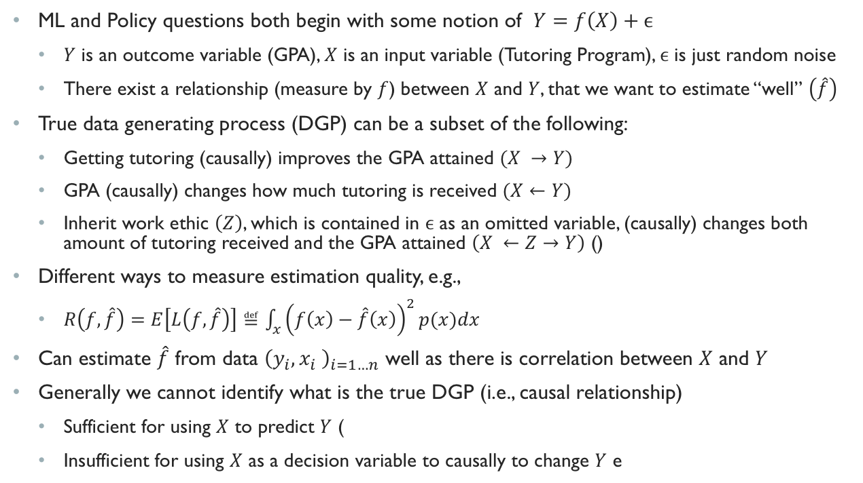
are These Two Even related?
ML and Policy questions both begin with some notion of $Y=f\left(X\right)+ϵ$
$Y$ is an outcome variable (GPA), $X$ is an input variable (Tutoring Program), $ϵ$ is just random noise
There exist a relationship (measure by $f$) between $X$ and $Y$, that we want to estimate “well” $\left(\hat{f}\right)$
True data generating process (DGP) can be a subset of the following:
Getting tutoring (causally) improves the GPA attained $(X →Y)$
GPA (causally) changes how much tutoring is received $(X←Y)$
Inherit work ethic $\left(Z\right)$, which is contained in $ϵ$ as an omitted variable, (causally) changes both amount of tutoring received and the GPA attained $\left(X ←Z→Y\right)$ ()
Different ways to measure estimation quality, e.g.,
$R\left(f,\hat{f}\right)=E\left[L\left(f,\hat{f}\right)\right]≝\int_{x}{{\left(f\left(x\right)−\hat{f}\left(x\right)\right)}^{2}p(x)dx}$
Can estimate $\hat{f}$ from data ${\left(y_{i},x_{i} \right)}_{i=1…n}$ well as there is correlation between $X$ and $Y$
Generally we cannot identify what is the true DGP (i.e., causal relationship)
Sufficient for using $X$ to predict $Y$ (
Insufficient for using $X$ as a decision variable to causally to change $Y$ e
Notes:
They seem like the are the anthesis of each other.
I can find an f hat that has good risk, that with either of the structure equations, would actually contend that I would learn a very similar f hat for each.
Correlation (which prediction uses) is a necessary condition for causation but not sufficient
If I just want to understand for a given X, what is a likely value of Y, this is sufficient as I do not care what caused the Y to be this value of X.
If your X is the pixels of an image and your Y is cat or Dog, then your DGP is simple

Slide 10
Have We Reached an Impasse?
Observation 1: Sometimes correlation is valuable on its own
Observation II: Sometimes goal is one of detection or discovery
Observation III: Sometimes correlation can be (forced into) causation
Notes:
I say no, if yes I wouldn’t be here
and I see the way forward broken down into 3 general but related observations, which are themselves are the “modules” for these lectures

Slide 11
Prediction For Policy
Observation 1: Sometimes correlation is valuable on its own

Slide 12
Motivation: AN Education Example
Large Classrooms
VS
Small Classrooms
Notes:
You are an educational administrator. One of your objectives is to ensure that students receive a high quality education, and one thing you maybe considering is how does the size of a classroom causally affect educational outcomes for students. Understanding this will allow you to develop educational policy that balances high quality education and costs, and decide should I lower the max classroom size.

Slide 13

Motivation: AN Education Example
Notes:
Let me give you another problem you likely face. How many teacher will I need to replace at the end of the school year. Good teachers are hard to come by and when a teacher leaves she takes with her all the tacit knowledge and investment with her. Additionally, the cost of replacing (good teachers) on short notice can be very high.

Slide 14
Motivation: AN Education Example
Classroom Size
VS
Teacher Turnover
Notes:
Both questions, classroom size and teacher turn over, is some function of Y = f(x)
However the former is a question of causality (what happens to test scores if I changed a student to a small classroom)
While the latter is one purely of prediction (we are not trying to change the behavior of the teacher, we simply are observing it).

Slide 15
Public Policy: A Story Prediction and Causality
There are many critical question that are challenges of prediction
Ex: Which teacher(s) will churn?
Predictions are (often implicitly) key variables into critical policy decisions
Ex: How many teachers to recruit next year—which impacts budgets, transfers, marketing, etc—depends on predicting teacher churn.
Prediction can lead to causation
Ex: Once I know which teachers are leaving, I may also want to intervene and incentive good teachers to stay.
Policy makers must “learn” to “classify” problems as those of prediction
Notes:
So what I want you to take away is that in Policy and Decision making there are a number of questions that are predictive and causal.
Predictions themselves often server as are key inputs into policy decisions. The only difference is if it’s a human’s intuition/informed best guess or a algorithm
But not only do predictions inform our decision making directly in a correlational way, they also shed light on potential causal questions we also want to address. What is the proper incentives to keep which teachers to stay is now again a question of causality.
Therefore a key skill is to “classify” (pun intended) which decision making problems are ones where pure prediction isvaluable and exploit ML and Big data to help solve this challenge.

Slide 16
Prediction For Policy: Training Data
Observation 1: Sometimes correlation is valuable on its own
Notes:
So the PUN is going to keep coming. Because in order for us to learn, we need training data!

Slide 17

The World’s Biggest Challenges
The 2030 Agenda for Sustainable Development, United Nations, 2015

Slide 18
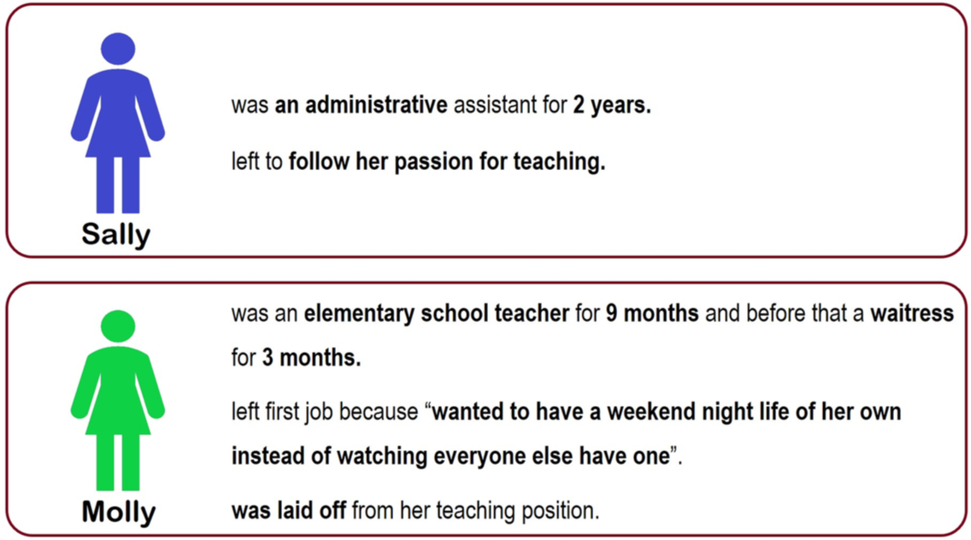
Hiring in Education
Who do you Hire?
Can ML HELP?
Discuss in Groups.
Characterize how you think this is typically accomplished?
Can this be structured as a challenge of prediction? How?
What kind of data would be necessary? Useful?
What are the features and outcomes of interests?
What benefits does ML offer?
S. Sajjadiani et al. “Using Machine Learning to Translate Applicant Work History into Predictors of Performance and Turnover,” (Working Paper).
Notes:
Would you hire sally molly or both? Why? Do you have biases?

Slide 19
Hiring in Education
Research Question: to what extent can resumes be used to generate a cheap, accurate, fair, credible signal to improve teacher hiring decisions?
Approach:
Link applicants’ resumes to effectiveness & retention as hires
Create theory-informed predictor variables from resume data
It is critical for policy challenges to include policy experts
Evaluate prediction-model’s value
S. Sajjadiani et al. “Using Machine Learning to Translate Applicant Work History into Predictors of Performance and Turnover,” (Working Paper).
Notes:
You want to be able to predict (from historical information-–i.e., resume, previous experience) who will be an effective teacher as well as how long they will stay. You want to hire teachers who are effective and will stay with you for a long time. You certainly do not want ineffective teachers who will stay for a long time. And there is some gray area for teach who will only stay shortly.
Note that you may argue that the inherent question is a causal one, what is the effect on student test scores of hiring one person vs another, but we will also show that the critical features we need are correlational!

Slide 20
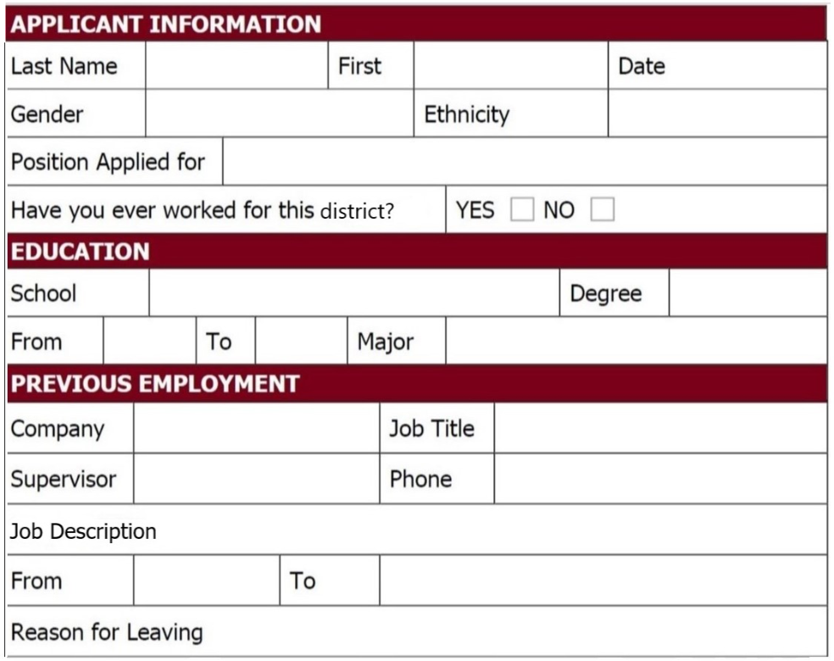
Hiring in Education
S. Sajjadiani et al. “Using Machine Learning to Translate Applicant Work History into Predictors of Performance and Turnover,” (Working Paper).

Slide 21
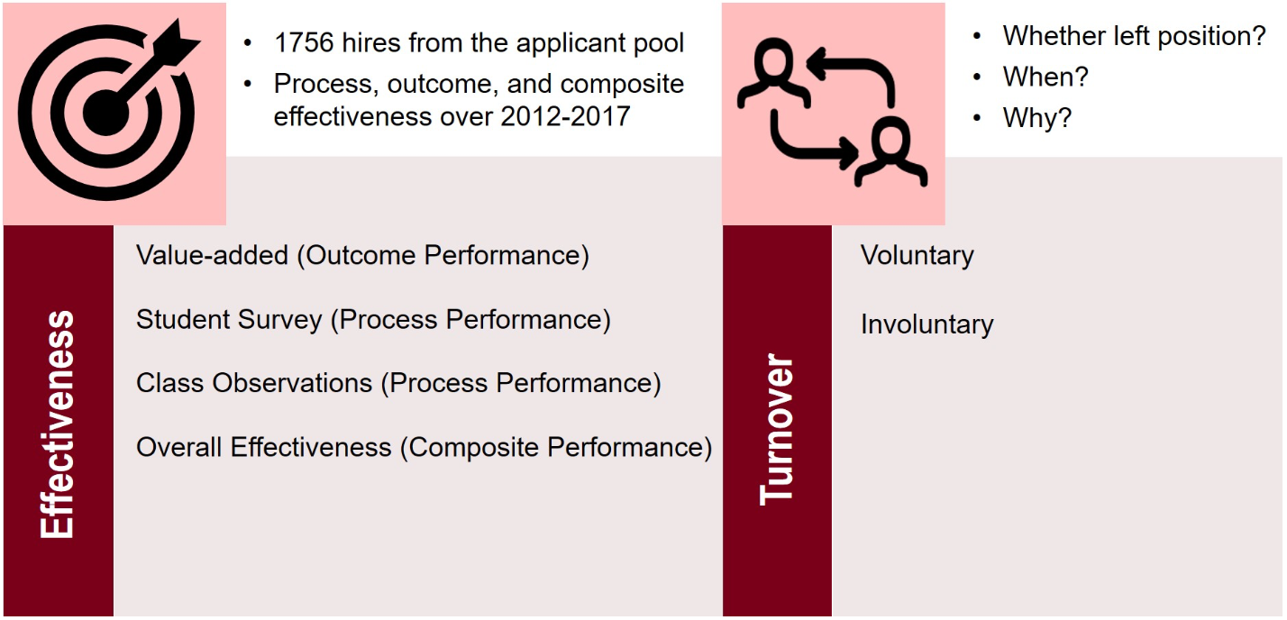
Hiring in Education
S. Sajjadiani et al. “Using Machine Learning to Translate Applicant Work History into Predictors of Performance and Turnover,” (Working Paper).

Slide 22
Critical Features
Work Experience Relevance
Positive association with teacher performance
Negative association with turnover hazard
Previous Tenure
Positive association with teacher performance
Negative association with turnover hazard
Turnover History
Involuntary
Positive association with teacher performance and negative with turnover hazard
Avoiding bad jobs
Negative association with teacher performance and negative with turnover hazard
Approaching better jobs
Positive association with teacher performance and negative with turnover hazard
S. Sajjadiani et al. “Using Machine Learning to Translate Applicant Work History into Predictors of Performance and Turnover,” (Working Paper).
Notes:
- Explain how Aaroon calculates these

Slide 23
Critical Features
Work Experience Relevance
Job description → Occupation Code → Occupation Dimensions → Relevant Experience
S. Sajjadiani et al. “Using Machine Learning to Translate Applicant Work History into Predictors of Performance and Turnover,” (Working Paper).

Slide 24
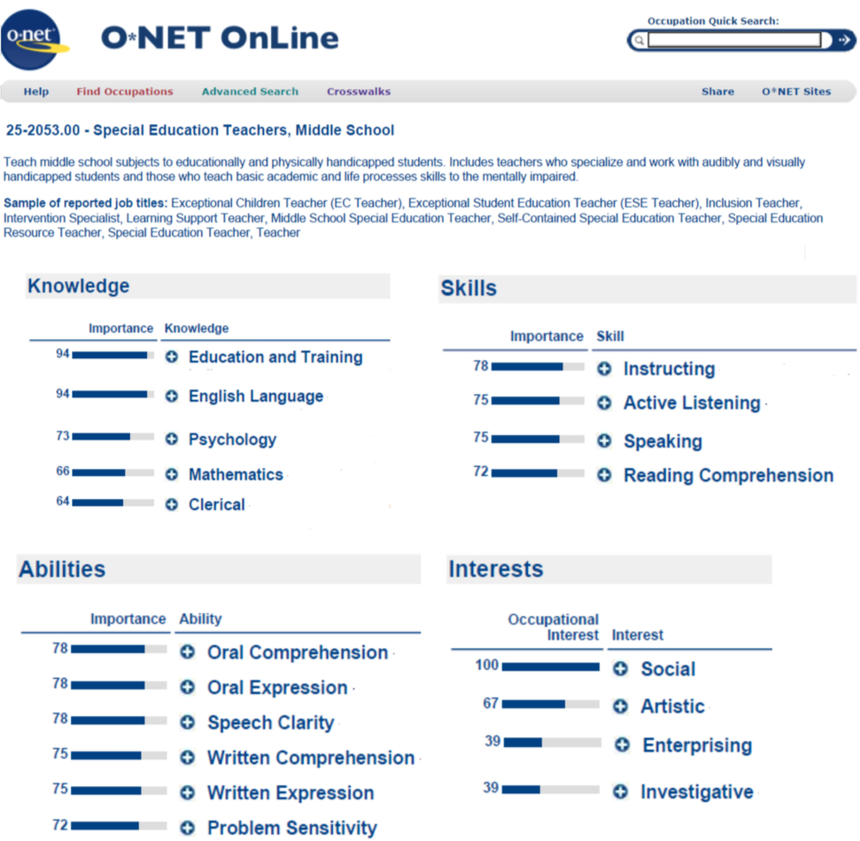
Critical Features
Work Experience Relevance
Job description → Occupation Code → Occupation Dimensions → Relevant Experience
Naïve Bayes trained on occupation descriptions, used to classify job titles and descriptions into Occupation Codes.
S. Sajjadiani et al. “Using Machine Learning to Translate Applicant Work History into Predictors of Performance and Turnover,” (Working Paper).

Slide 25
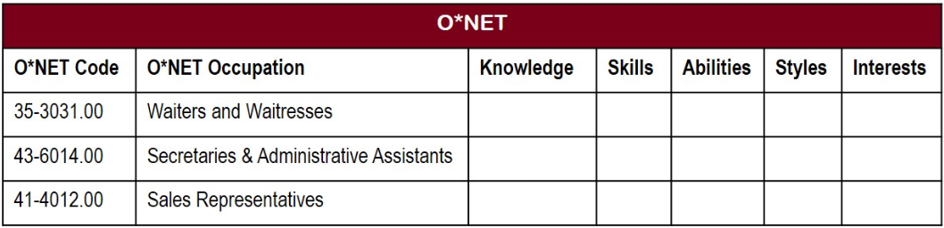
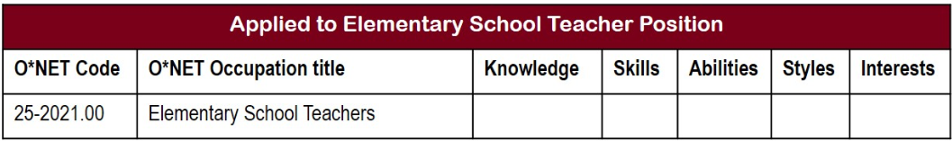
Critical Features
Work Experience Relevance
Job description → Occupation Code → Occupation Dimensions → Relevant Experience
Naïve Bayes trained on occupation descriptions, used to classify job titles and descriptions into Occupation Codes.
S. Sajjadiani et al. “Using Machine Learning to Translate Applicant Work History into Predictors of Performance and Turnover,” (Working Paper).
Notes:
Allowing us to compare the cateogrizations obtained from historical occupations…
…to the sills necessary for the school teacher position being applied for.
This is simply a question of prediction!

Slide 26
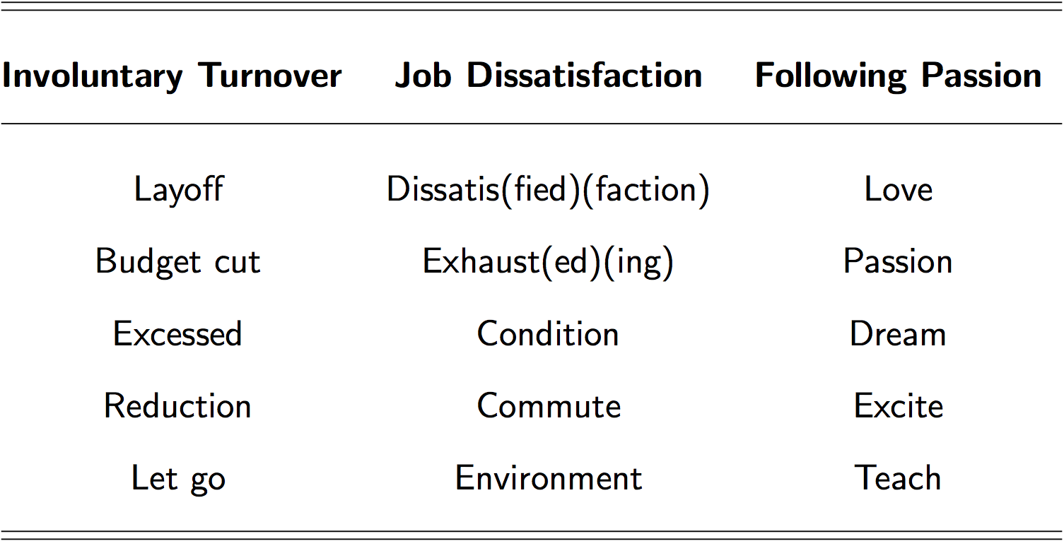
Critical Features
Work Experience Relevance
Job description → Occupation Code → Occupation Dimensions → Relevant Experience
Naïve Bayes trained on occupation descriptions, used to classify job titles and descriptions into Occupation Codes.
Turnover History
Take a small sample, and hand code reasons for turnover (Involuntary, Avoiding bad jobs, Approaching better jobs)
Naïve Bayes trained on these labeled examples to predict turnover reason.
S. Sajjadiani et al. “Using Machine Learning to Translate Applicant Work History into Predictors of Performance and Turnover,” (Working Paper).
Notes:
Allowing us to compare the cateogrizations obtained from historical occupations…
…to the sills necessary for the school teacher position being applied for.
This is simply a question of prediction!

Slide 27
Other Features
Tone (Linguistic Inquiry and Word Count Software, Pennebaker et al., 2015)
Spelling accuracy
Propensity for job-hopping
Teaching experience
Education
Number of previous jobs
Overall work experience
Unemployment gaps
Application year
Position type
Demographics (missing data imputed)
Quality and Quantity of competition faced by applicant (used for IV)
S. Sajjadiani et al. “Using Machine Learning to Translate Applicant Work History into Predictors of Performance and Turnover,” (Working Paper).
Notes:
- Explain how Aaroon calculates these

Slide 28
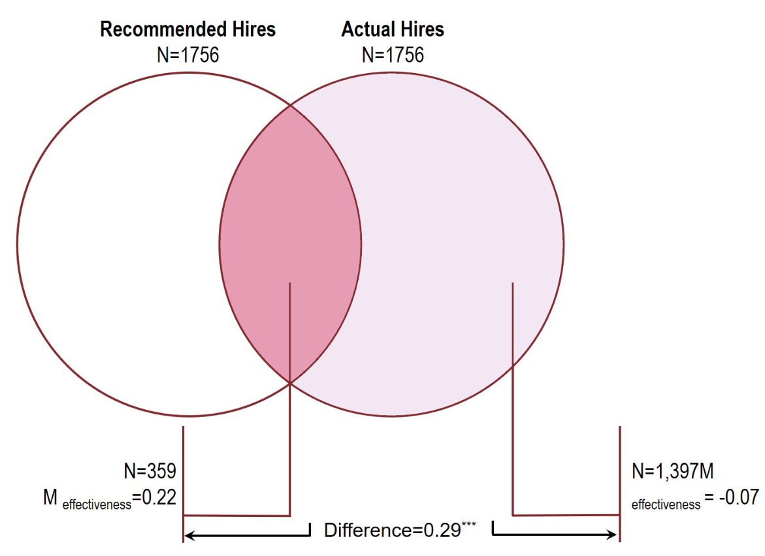
Results

Slide 29
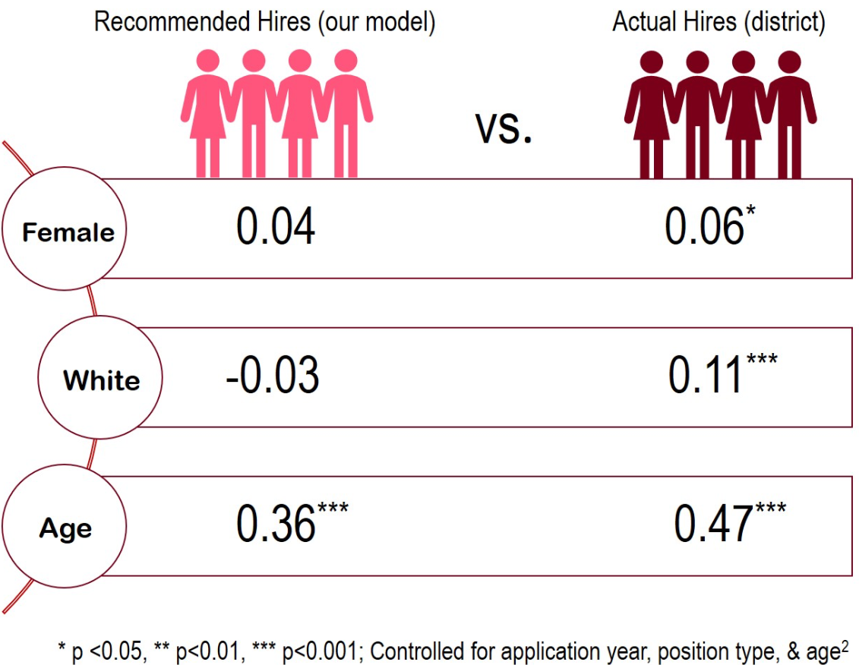
Results

Slide 30
The World’s Biggest Challenges
✓

Slide 31
Poverty
Eliminating Poverty is critical UN Sustainable Development Goal
To address this problem we first need to have accurate measure of poverty by location
Traditional surveys are expensive and inefficient
How can ML help capture poverty in various areas?
Discuss in groups.
Can this be structured as a challenge of prediction? How?
What kind of data would be necessary? Useful?
What are the features and outcomes of interests?
What benefits does ML offer?
Notes:
Poverty is a real challenge: https://www.youtube.com/watch?v=jZNKihHJZqA
What benefit do we think we could derive from being able to predict/estimate poverty of certain locations
Understand where we should distribute resources. Evaluate policy. Hard to solve the problem if you do not know exactly where the target population is.
Traditional surveys are expensinve (400k t0 1.5 mil), not scalable and response rates are low
How can we do this?
Solving it: https://www.youtube.com/watch?v=DafZSeIGLNE
What Data do we have available?
Sateliate Data
What are the benefits
Cheap, Scalable, Granular spatial and temporal resolution globally.
Images contain signal of information that is correlated with poverty just unstructured
How many roads a area has
Vehichles
Open area vs buildings
People
Ships in ports
Aggriculutural yield—speed at which it is harvested.
We don’t have lots of traning data on this. So we use Transfer learning
Nighttime light as a proxy for economic development
Poverty has spatial autocorrelation
http://sustain.stanford.edu/predicting-poverty/
https://github.com/nealjean/predicting-poverty

Slide 32

Notes:
LiveSlide Site
https://youtu.be/DafZSeIGLNE

Slide 33
Poverty
What were the challenges?
Only a small number poverty level labels are known
Unclear which features are important to predict poverty levels of an area
Inefficient/Costly to conduct surveys to solve these issues
How were they overcome?
Poverty levels highly correlated with different features of economic development
Economic development can be captured through high resolution images
Poverty levels (and therefore economic development) also highly correlated with intensity of light levels at night
Learn how night light intensity predicts poverty levels in the locations where labels are known
Use algorithms to learn “features” in daytime images that predict night light intensity
Infrastructure, Roads, Amount of Urban Areas/Farmland, Waterways etc.
Final Results: Day images feature → Night light intensity → Poverty level
N. Jean et al. (2016). Combining satellite imagery and machine learning to predict poverty. Science, 353(6301), 790–794.
Notes:
How can we do this?
Solving it: https://www.youtube.com/watch?v=DafZSeIGLNE
What Data do we have available?
Sateliate Data
What are the benefits
Cheap, Scalable, Granular spatial and temporal resolution globally.
Images contain signal of information that is correlated with poverty just unstructured
How many roads a area has
Vehichles
Open area vs buildings
People
Ships in ports
Aggriculutural yield—speed at which it is harvested.
We don’t have lots of traning data on this. So we use Transfer learning
Nighttime light as a proxy for economic development
Poverty has spatial autocorrelation
http://sustain.stanford.edu/predicting-poverty/
https://github.com/nealjean/predicting-poverty

Slide 34
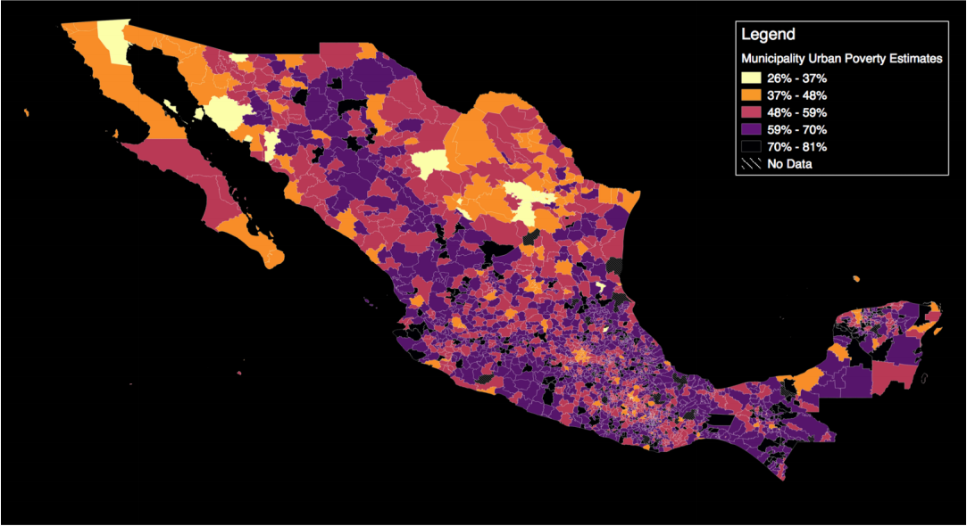
Poverty
Does this work in other countries?
Babenko et al. does something similar in Mexico
Notes:
Allowing us to compare the cateogrizations obtained from historical occupations…
…to the sills necessary for the school teacher position being applied for.
This is simply a question of prediction!

Slide 35
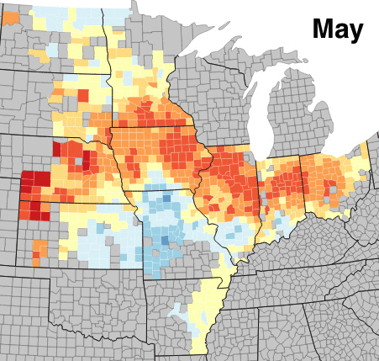
Poverty
Does this work in other countries?
Babenko et al. does something similar in Mexico
Does this work for other contexts?
You et al. does something similar for predicting crop yields.
Notes:
Allowing us to compare the cateogrizations obtained from historical occupations…
…to the sills necessary for the school teacher position being applied for.
This is simply a question of prediction!

Slide 36
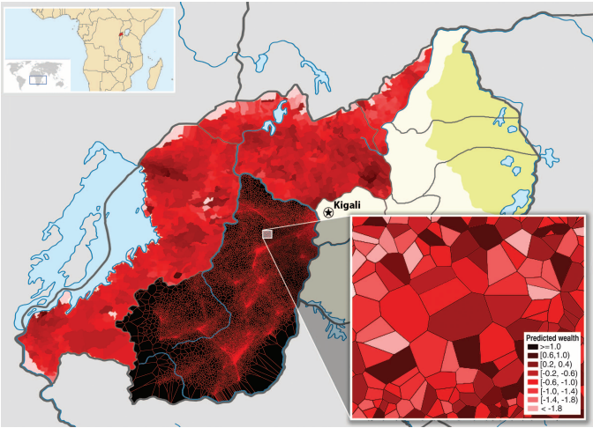
Poverty
Does this work in other countries?
Babenko et al. does something similar in Mexico
Does this work for other contexts?
You et al. does something similar for predicting crop yields.
Can we get more granular?
Blumenstock et al. predicts individual poverty levels based on historical cell phone call records.
Notes:
. Construction of high-resolution maps of poverty and wealth from call records. Information derived from the call records of 1.5 million subscribers is overlaid on a map of Rwanda.The northern and western provinces are divided into cells (the smallest administrative unit of the country), and the cell is shaded according to the average (predicted) wealth of all mobile subscribers in that cell. The southern province is overlaid with a Voronoi division that uses geographic identifiers in the call data to segment the region into several hundred thousand small partitions. (Bottom right inset) Enlargement of a 1-km2 region near Kiyonza, with Voronoi cells shaded by the predicted wealth of small groups (5 to 15 subscribers) who live in each region.
http://sustain.stanford.edu/crop-yield-analysis
Blumenstock, JE, Cadamuro, G, On, R (2015). Predicting Poverty and Wealth from Mobile Phone Metadata, Science, 350(6264), 1073-1076 [pdf]
http://www.jblumenstock.com/files/papers/jblumenstock_2015_science.pdf

Slide 37
The World’s Biggest Challenges
✓
✓
✓
Notes:
So not only do we get poverty, but we also touch on hunger

Slide 38
Inclusive Finance
2-3 BILLION individuals and 200 MILLION businesses in emerging economies today lack access to savings and credit, and even those with access can pay dearly for a limited range of products.
McKinsey Global Institute, Digital finance for all: Powering inclusive growth in emerging economies, 2016

Slide 39
Inclusive Finance
Goal 8.10 of the “SDGs”
Strengthen the capacity of domestic financial institutions to encourage and expand access to banking, insurance and financial services for all.
McKinsey Global Institute, Digital finance for all: Powering inclusive growth in emerging economies, 2016

Slide 40
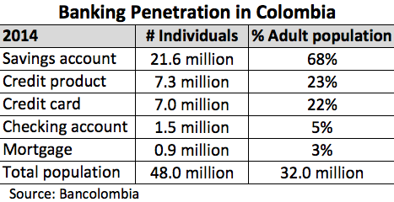
Inclusive Finance
Access to credit can be extremely valuable
Lenders face two challenges with unbanked population
How to evaluate the credit worthiness of a loan seeker
How to transact with a loan seeker
Discuss in groups.
Can this be structured as a challenge of prediction? How?
What kind of data would be necessary? Useful?
What are the features and outcomes of interests?
What benefits does ML offer?
Notes:
These numbers are clearly a little old, but the idea is that banking penetration is not extremely high
Such lack of penetration presents a problem because we know that access to capital (or credit) (even small amounts) can be extremely valuable especially for those who are poor.
A challenge faced by lenders is two fold
How compute a credit score for a customer given that they have very little or no financial history?
https://www.farinternational.com/banking-in-colombia-mortgages/

Slide 41
Inclusive Finance
Notes:
Let’s stay with this idea of using mobile.
Although most comparable sources of big data are scarce in the world’s poorest nations, mobile phones are a notable exception: They are used by 3.4 billion individuals worldwide and are becoming increasingly ubiquitous in developing regions
We can see here for Colombia that The population is 49 million and we can see that mobile is seems about 2x as more popular than internet.
Why is this important you may ask?

Slide 42
Inclusive Finance
Mobile Money platforms provide a coinvent way to send/receive money over mobile phones
Under-banked populations now have access to previously unavailable credit
Mobile network usage data provides a rich set of features
From Airtime usage patterns to the credit-worthiness of network “friends”
Notes:
Mobile money platforms reduces the barrier-to-entry to simply owning a mobile phone, which is common even for those who are unbanked or our poorer.
This allow banks to transact with very little cost
But what about credit worthiness?
Well we just saw that cell phone usage can be used to predict wealth. And given the penetration of mobile, the question remains what else can we do with it?

Slide 43
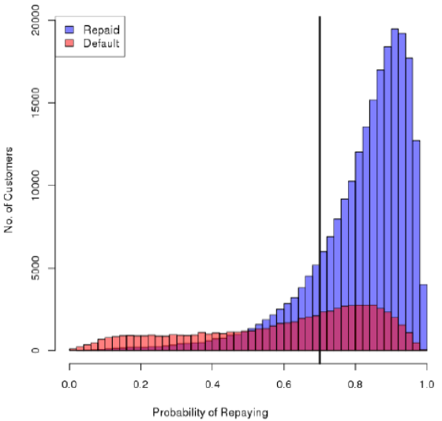
Inclusive Finance
(specificity)
(sensitivity or recall)
Retained 83% of paying customers
Identified 55% of would-be defaulters
Speakman

Slide 44
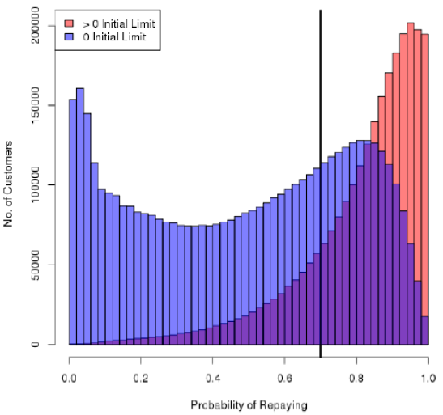
Inclusive Finance
+1 Million customers receive credit
Speakman

Slide 45
The World’s Biggest Challenges
✓
✓
✓
✓
Notes:
Notice that 5 and 10 are about inequality experiences by margaminzled groups…and although we may feel like ML can help us solve these, it can also introduce additional inequality

Slide 46
The Importance of FATE
Fairness, Accountability, Transparency, and Ethics (FATE)
We continue to rely more and more on algorithms to decide who gets
hired, a loan, parole from jail, etc.
We have to insure that the algorithm’s decisions are not biased
People trust models because they “appear” to remove human bias but this does not mean they are devoid of algorithmic bias
The machine is learning, but we provide the textbook to teach it.
Notes:
They appear to remove huan bias because instead of humans hiring somone based on soely on biased metrics, an alogithm is hyper rationle.
http://www.jennwv.com/papers/datasheets.pdf
https://www.technologyreview.com/s/608248/biased-algorithms-are-everywhere-and-no-one-seems-to-care/
https://medium.com/mit-media-lab/the-algorithms-arent-biased-we-are-a691f5f6f6f2

Slide 47
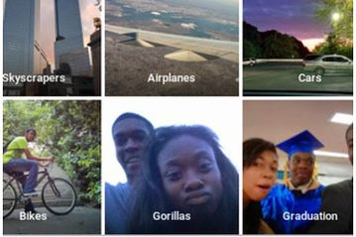
The Importance of FATE
Notes:
Or a racist: Image recognition or trying to help you improve your selfies
https://beta.techcrunch.com/2017/04/25/faceapp-apologises-for-building-a-racist-ai/?_ga=2.76873941.1708958679.1529627100-1981257813.1527711128
https://techcrunch.com/2017/04/30/algorithmic-accountability/

Slide 48
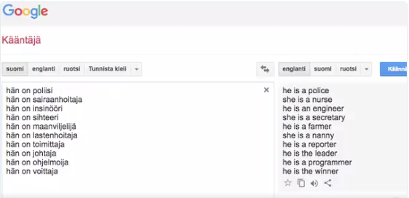
The Importance of FATE
Notes:
Or a racist: Image recognition or trying to help you improve your selfies
https://twitter.com/TaikaDahlbom/status/935612093906194432?ref_src=twsrc%5Etfw&ref_url=https%3A%2F%2Fmashable.com%2F2017%2F11%2F30%2Fgoogle-translate-sexism%2F

Slide 49
Notes:
LiveSlide Site
https://youtu.be/_CdJ4oae8f4

Slide 50
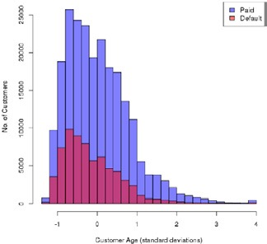
The Importance of FATE
Notes:
If we revisit our lending example. Looking at age, it would appear that algorithm should learn that younger borrowers are riskier than older borrowers. It may therefore bias itself to being an agist.

Slide 51
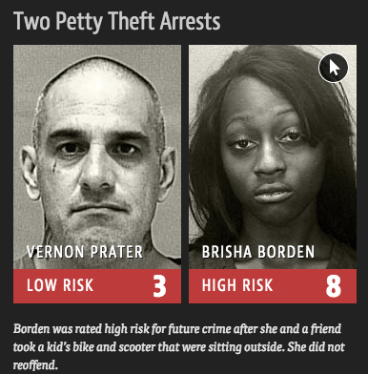
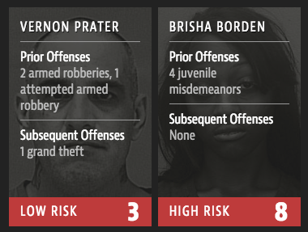
The Importance of FATE
Notes:
https://www.propublica.org/article/machine-bias-risk-assessments-in-criminal-sentencing

Slide 52
Prediction For Policy
Observation 1: Sometimes correlation is valuable on its own
Notes:
So in summary, our take away message is that there are a number of policy relevant questions that are ripe for prediction, because sometimes correlation on its own is valuable. However, we do need to remember that just like in human decision making, bias can creep into algorithms as well.

Slide 53
References
Sima Sajjadiani, Aaron J. Sojourner, John D. Kammeyer-Mueller & Elton Mykerezi. (2018). Using Machine Learning to Translate Applicant Work History into Predictors of Performance and Turnover. Working Paper.
Jean, N., Burke, M., Xie, M., Davis, W. M., Lobell, D. B., & Ermon, S. (2016). Combining satellite imagery and machine learning to predict poverty. Science, 353(6301), 790–794. http://doi.org/10.1126/science.aaf7894
Boris Babenko, Jonathan Hersh, David Newhouse, Anusha Ramakrishnan, Tom Swartz. (2017).. Poverty Mapping Using Convolutional Neural Networks Trained on High and Medium Resolution Satellite Images, With an Application in Mexico. arXiv.org.
Blumenstock, JE, Cadamuro, G, On, R (2015). Predicting Poverty and Wealth from Mobile Phone Metadata, Science, 350(6264), 1073-1076.

Slide 54
Videos to Watch
ML and Policy (Sendhil Mullainathan)
https://youtu.be/W7izsrYGhdU
Bias in ML (Kate Crawford)
https://youtu.be/fMym_BKWQzk

